Slide 1
Linear Algebra & Medical Imaging
Automating Brain Tumor Detection
Wesley Chen and Brandon Sim

Slide 2
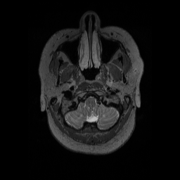
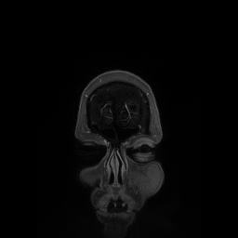
Introduction of MRI
Wide range of use across all organs to detect bleeding, tumors, etc
10,000 MRI Machines in the United States
Many 2D slices to form the 3D model

Slide 3
Motivation
Problem lends itself to linear algebra – we represent grayscale images as matrices of numbers – allows us to use matrix manipulations, run algorithms
Reduces intra- and inter-rater measurement variability through automation
Provides one more “safety layer” in case something is missed by a radiologist or physician
Saves time and may allow for better quality of care

Slide 4
Previous Work
Other papers in this field have attempted a large variety of methods – ranging from combinations of filters to edge detection algorithms to machine learning algorithms.
Here we use two methods: symmetry analysis, an original method, and watershed segmentation, based on the literature.
2 approaches > 1

Slide 5
Two Independent Approaches
Symmetry Analysis
Use filtering techniques to detect edges
Detect closed loops
Analyze symmetry of configuration to assign probability of successful tagging of tumor
Watershed Segmentation
Treat grayscale image as topology
Identify foreground vs. background
Use this to segment image

Slide 6
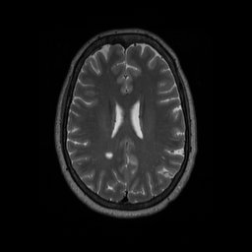
The Original MRI Image (one slice)
Data source: (dataset for academic use). Dr. Steve Stufflebeam, Director, Clinical Magnetoencephalography, Mass. General Hospital

Slide 7
Symmetry Analysis

Slide 8
Algorithm
(1) Detect axis of symmetry in image by finding ellipse that has same normalized second central moment as region (“least squares”)
(2) Detect edges using Gaussian filter
(3) Detect all closed objects using edges in (2)
(4) Reflect each closed object across axis of symmetry and calculate overlapped area
(5) Clustering – calculate centroids of each closed object to verify results from (4)

Slide 9
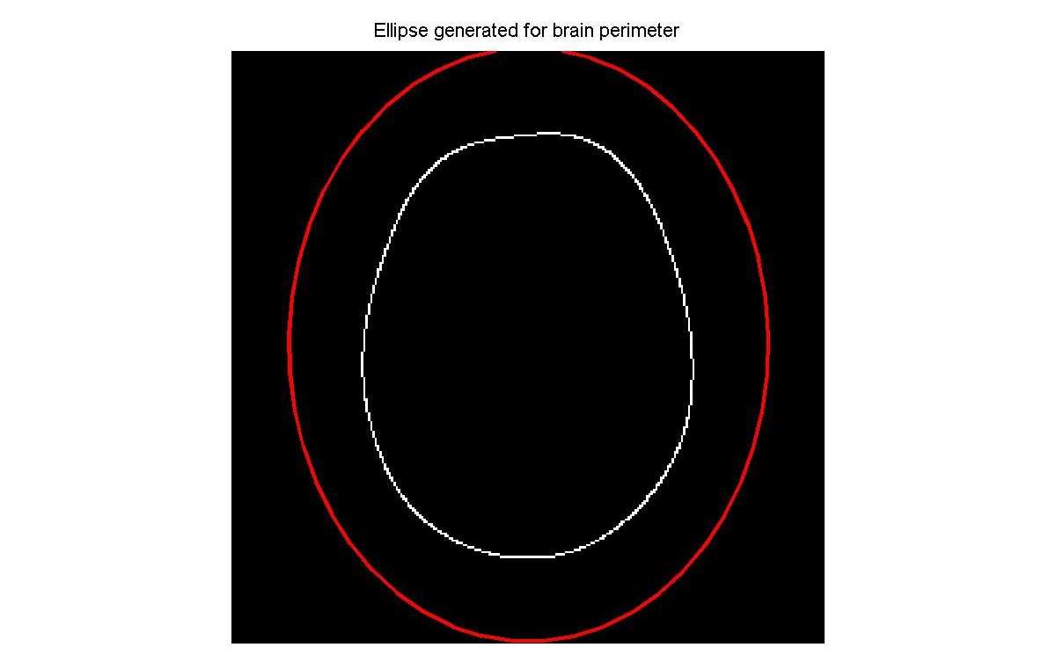
Detecting Axis of Symmetry

Slide 10
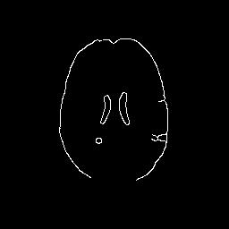
Detecting Edges (Canny) (filters)

Slide 11
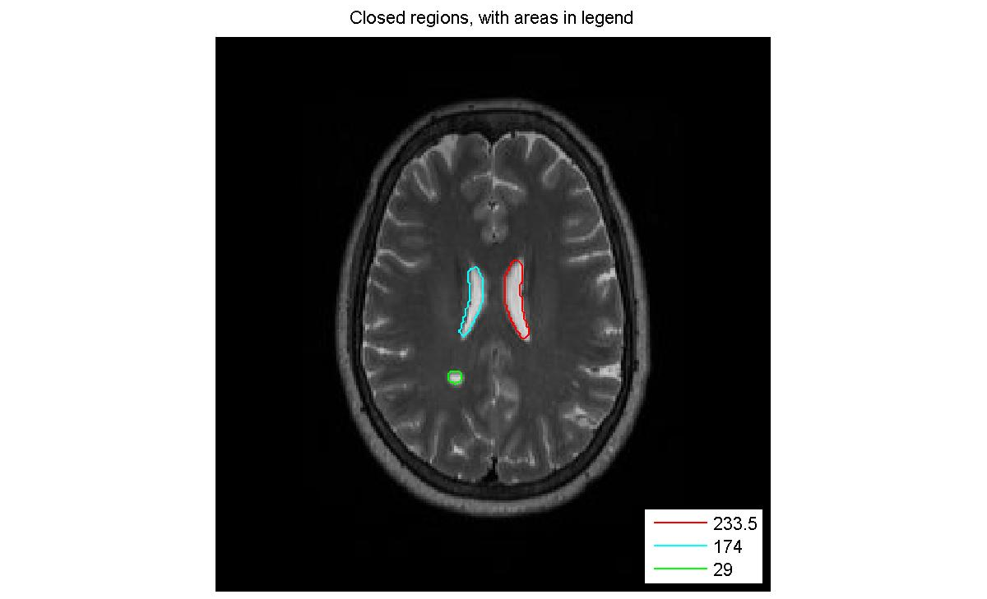
Detecting Closed Regions

Slide 12
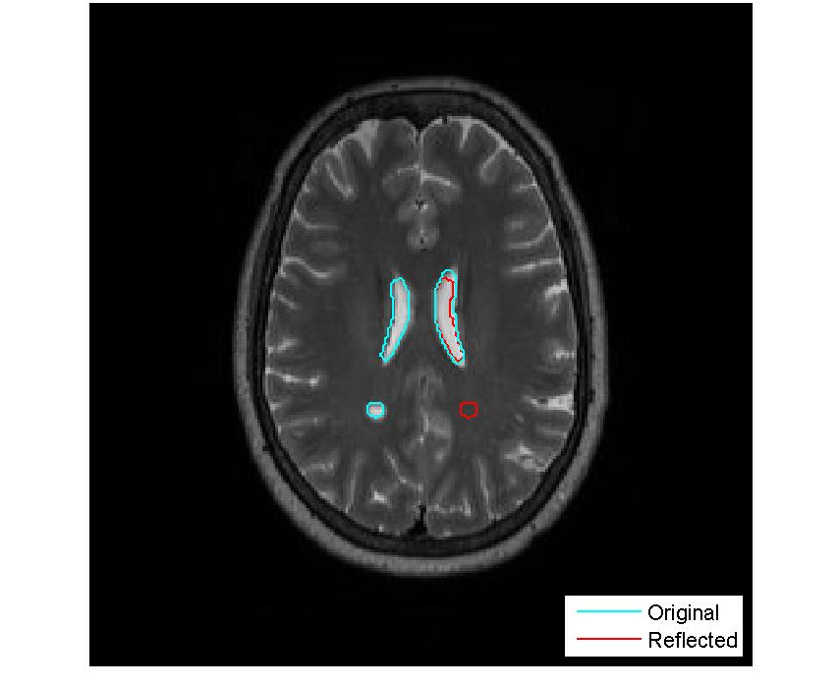
Reflecting over Axis, Calculate Overlap

Slide 13
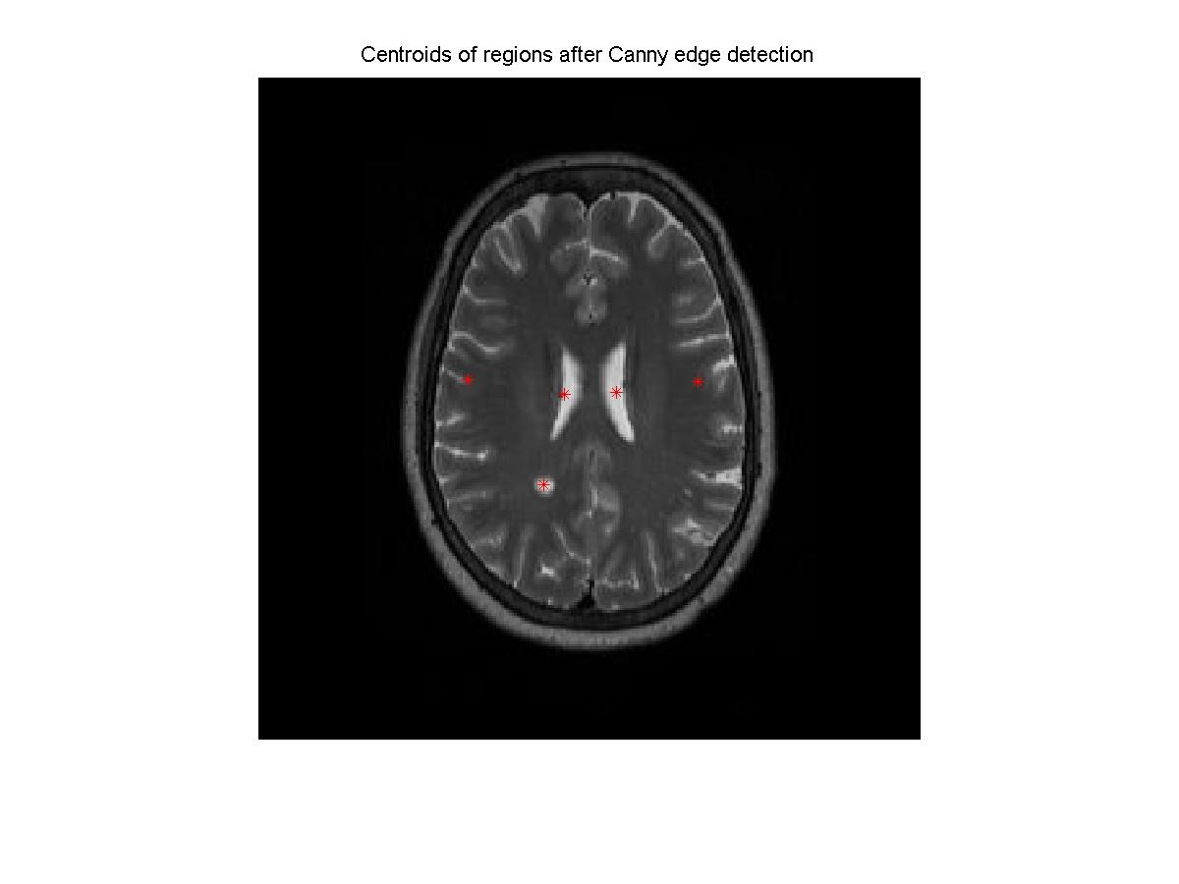
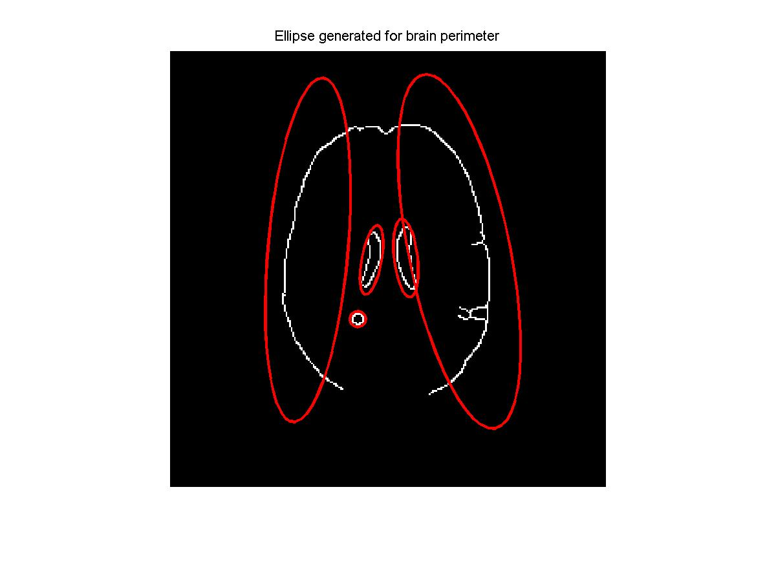
Generate Ellipses with Centroids

Slide 14
Symmetry algorithm, x130
Images above are from running our algorithm on one slice of the brain
We can repeat on all slices, then analyze the 3-dimensional data to retrieve tumor candidates
Dimension reduction – simple adjacent Euclidean distance.

Slide 15
Symmetry Algorithm on Stack of Images
Calculated centroids of ellipses as described earlier
Reflected across axis of symmetry as described earlier to eliminate those centroids that are symmetric across axis (probably not tumor)
Calculated score based on Euclidean distance
The lower the score, the better – this means that the difference in suspect location as a function of height is not high

Slide 16
Output Results
Recall: tumor seen here ->
Matlab output:
Warning: possible tumor detected. Frames 79, 80; Difference: 0.61936
ans =
110.7500 157.3500
ans =
Warning: possible tumor detected. Frames 80, 81; Difference: 0.66165
ans =
111.0000 157.9167

Slide 17

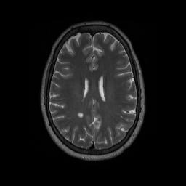
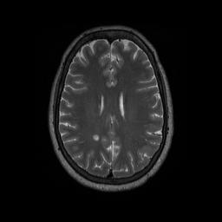
What Frames are Those?
79
80
81

Slide 18
Future outlook for this code
Since all MRI data come in stacks of slices of images, this code is generalizable
All our code is written in a modular way in MATLAB – functions for reflection, calculating overlapping areas, detecting edges, etc. are all separate
Modularity allows for reuse
Very few “magic numbers” – reusable code

Slide 19
Watershed Segmentation

Slide 20

MRI Original and Lily Pad Landscape

Slide 21
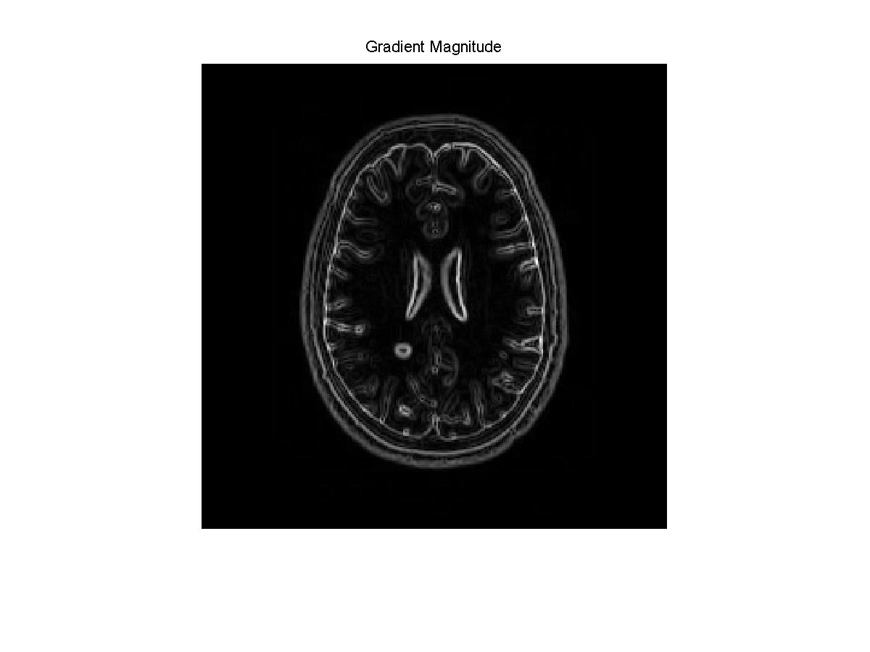
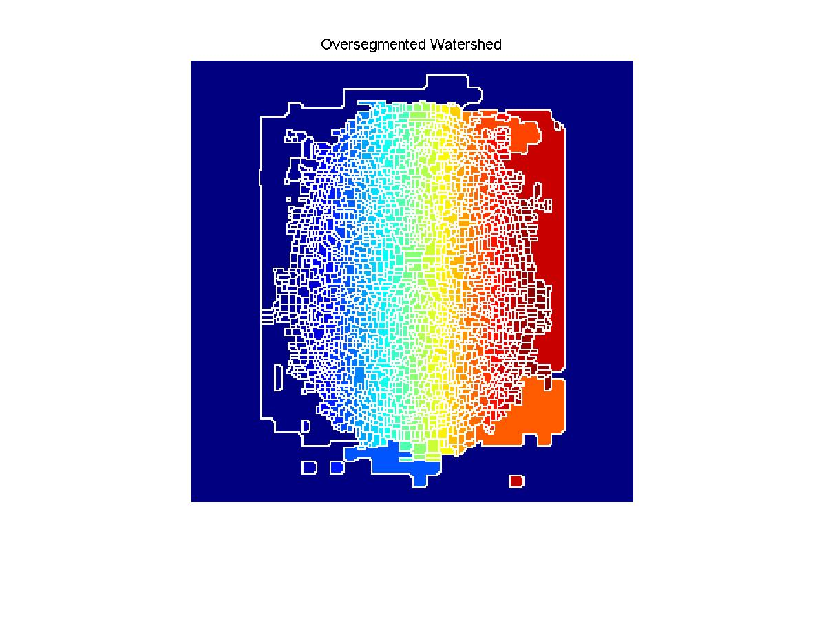
Watershed: Pure Gradient MRI

Slide 22
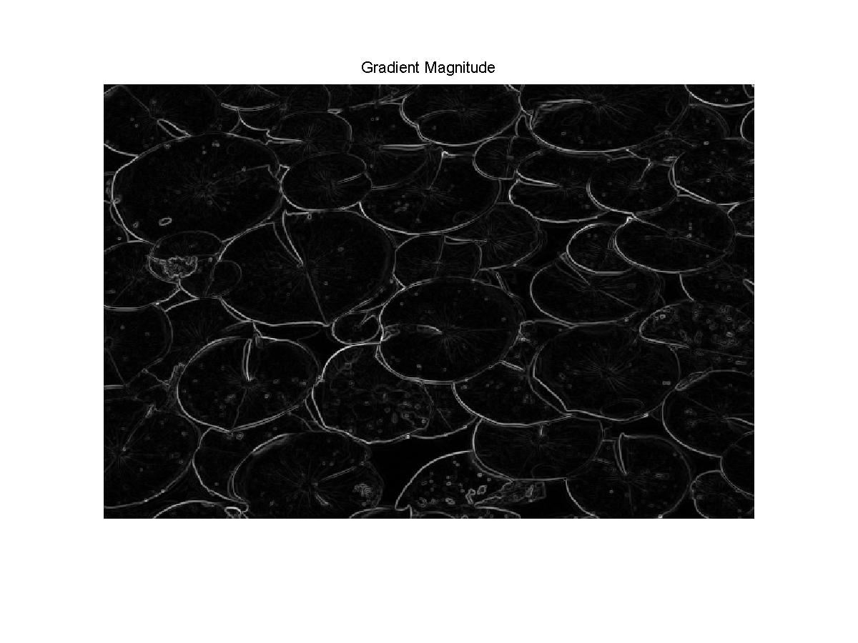
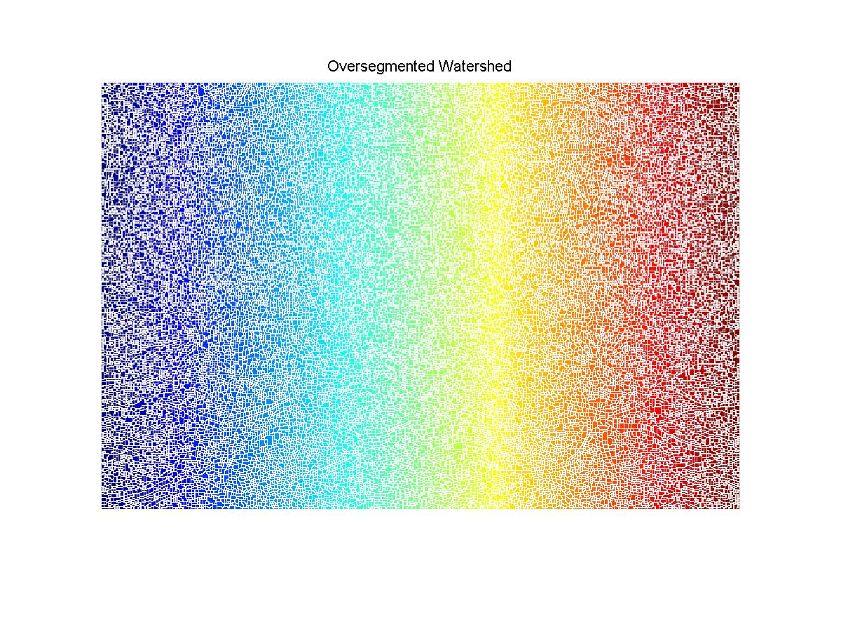
Watershed: Pure Gradient Lily Pad

Slide 23
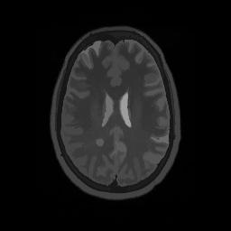
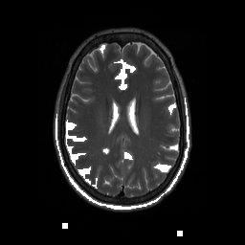
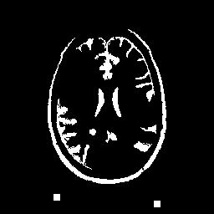
Watershed: Marking Foreground MRI

Slide 24

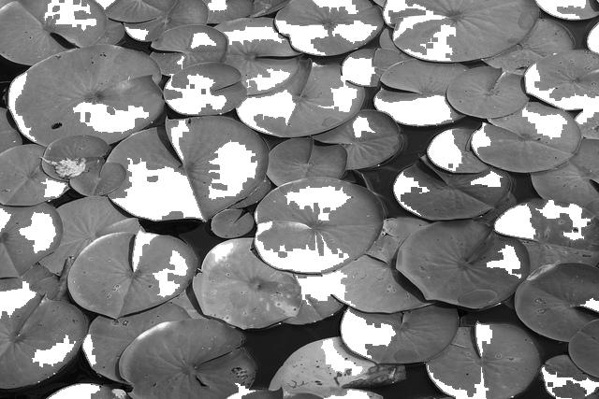
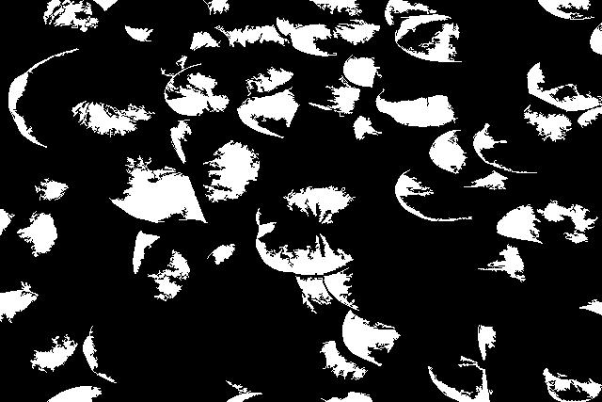
Watershed: Marking Foreground Lily

Slide 25
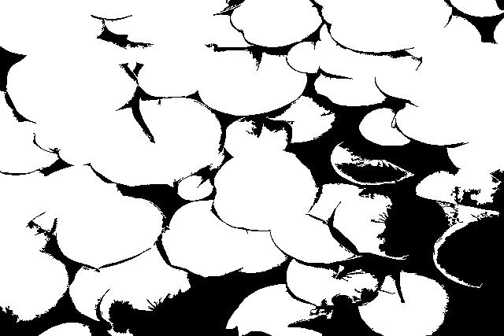
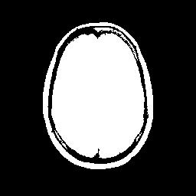
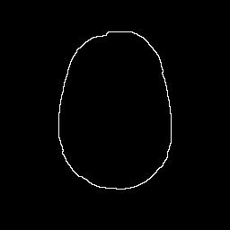
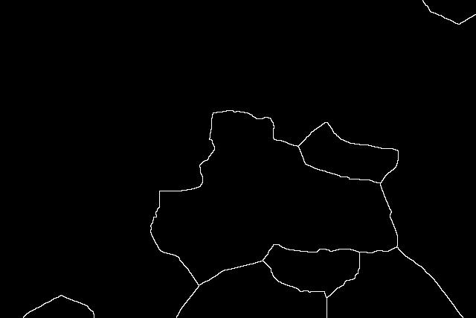
Watershed: Finding Background

Slide 26
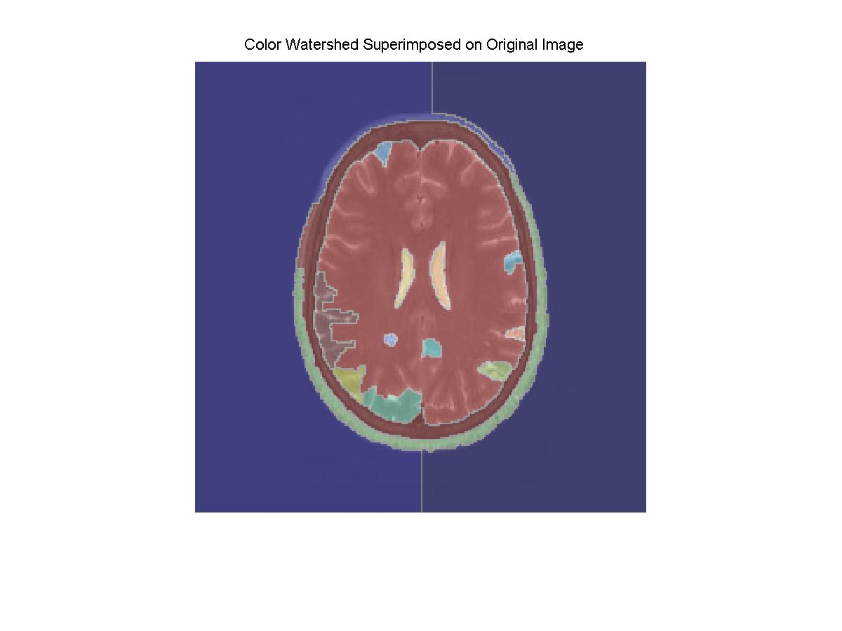
Watershed: Colored Visualization MRI

Slide 27
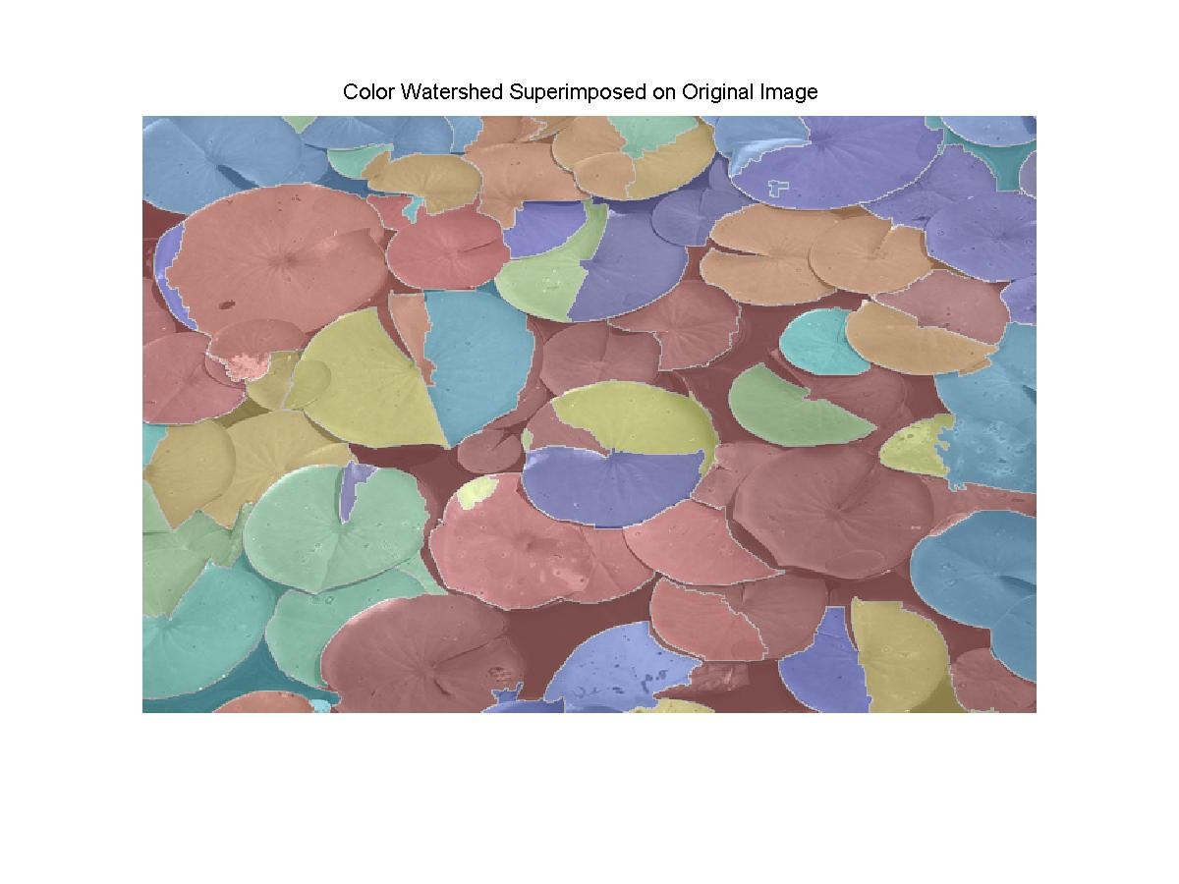
Watershed: Colored Visualization Lily

Slide 28
Discussion
Help pre-filter data for doctors
False Positives
Give suggestions of mostly likely candidates
Symmetry Analysis
Simple and clean
May miss complex tumors
Watershed
More complex and not as clean for smaller tumors
Will detail all areas, less false negative

Slide 29
Future Work
Integrate the two separate approaches
Use different angles of the MRI data (instead of top-down only)
Further cross-check centroid data in symmetry algorithm with closed object data to ensure that all positive matches are actual objects (decrease false positive rate)
Better dimension reduction algorithm when analyzing data from 3-d stack of images

Slide 30
Thanks!
Thanks to:
Professor Santillana
Steve Stufflebeam, for images

